Slide 1

_{BACHELOR OF TECHNOLOGY}
_{IN}
Artificial Intelligence and Machine Learning
Application Development –Deep Learning Explore ( MR22-1CS0203)
_{Section:Theta}
Project Title:Music Gen Batch Number:TT-15
_{Roll Numbers:2211CS020609}
_{2211CS020610}
_{2211CS020611}
_{2211CS020613}
_{2211CS020614}
Project Guide : Prof Dr.Thayyaba Khatoon
Department of AIML, School of Engineering
_{Malla Reddy University}
Department of AIML, School of Engineering
_{Malla Reddy University}

Slide 2
CONTENTS
Abstract
(About abstract of your project)
Literature
(Research existing solutions and approaches for similar problems
Define the technical requirements and constraints of your project
Outline the steps and components needed for your application )
Problem Statement
Should articulate the issue that needs addressing
Frame the problem statement, kind of solutions
Output of the Models ( Ex : Prediction, Detection……)
Data Collection and Exploration
Gather and curate the necessary data for your project
Conduct exploratory data analysis to understand the dataset/image set…
Clean and preprocess the data, handling missing values and outliers
Perform data transformation and feature engineering as needed
Model Selection and Architecture
(Choose the appropriate deep learning model(s)
Design the architecture of your model and its layers )

Slide 3
Deployment & Results
Model Deployment:
How implementation is done..
what are the evaluation metrics used
what is the testing data, testing methodologies have used
Web Application & Integration –
Show all GUI’s interfaces
Results – Any output results via visualization or graphs
Conclusion
Project Conclusion
Future Scope

Slide 4
ABSTRACT:
MUSICGEN project explores AI-driven music generation through our neurotune application, enabling users to create songs using neural networks. This report details the methods and models employed, including Recurrent Neural Networks (RNNs), Long Short-Term Memory (LSTM) networks, and LSTMs with attention mechanisms. Music, while structured, is a complex form of language traditionally associated with human creativity and emotion.

Slide 5
LITERATURE
Existing Applications:
Mubert
Purpose: Generating Music Through Facial Recognisation
Functionality: Mubert is an AI-powered app that creates music in real-time based on mood, activity, or music genre, and the app will instantly generate a continuous stream of unique music. It’s perfect for background music while you work, relax, or focus and can even use in your own projects like videos or podcast. It’s an easy way to get personalized, endless music tailored to your needs.
EmoComposer
Melomics

Slide 6
Software Requirements Specification:
Software Requirements:
Operating System:Windows
User Interface:HTML,CSS
Client-Side Scripting:Python
Programming Language:Python
Hardware Requirements:
Hard Disk:512 GB
RAM:recommended 8gb

Slide 7
PROBLEM STATEMENT
The limitations of traditional music generation techniques often lead to repetitive and generic outputs that fail to capture the complexity of human emotions and not accurately reflect the user's current emotional state as they are based on genre and mood.An innovative solution that integrates real-time facial expression analysis with music generation algorithms to create adaptive and emotionally resonant music experiences. Detects facial expressions, translating these emotions into appropriate musical elements, and ensuring that the generated music reflects the subtleties and dynamics of the user's emotional state is the main aspect

Slide 8
Deployment & Results
Model Deployment:
Objective Definition: Clearly outline what you want to achieve—such as how different facial expressions correspond to specific music genres or moods.
Technology Selection: Choose tools and technologies for facial recognition and music playback. Common options include:Facial Recognition Libraries: OpenCV, Dlib, or Mediapipe for detecting and analyzing facial expressions.Music Libraries: APIs like Spotify or local music playback libraries:Data
Collection: Gather data on facial expressions and their corresponding emotional states.
This could involve using a pre-existing dataset or collecting your own data with participants expressing different emotions.
Expression Analysis:Use facial recognition algorithms to analyze expressions in real-time.Map these expressions to emotional states (e.g., happiness, sadness, anger).
Integration: Combine the facial recognition and music playback functionalities. When an expression is detected, the corresponding music plays automatically
Testing and Feedback: Test the system with users, gather feedback, and make necessary adjustments. Ensure that the system responds accurately to a range of facial expressions.
Deployment: Launch the project, making it accessible for users, and consider options for further enhancements based on user interactions.

Slide 9
DATA COLLECTION:
Data Collection: Facial expression recognition (FER) uses systems like OpenFace, MediaPipe, or deep learning models to capture expressions by extracting key facial landmarks. These are classified into emotions (e.g., happy, sad, angry) using algorithms that output a probability vector for each emotion.
Handling Missing or Noisy Data: To manage missing or distorted data in videos, interpolation can be used to fill in gaps by predicting missing frames or key points that might be obscured or incorrectly detected. Additionally, outlier detection techniques, such as statistical methods or anomaly detection algorithms, can be employed to identify and correct unusual facial expression data, leading to smoother and more accurate results.
DATA EXPLORATION:
Feature Extraction and Encoding: Feature extraction involves normalizing facial landmarks to account for variations in distance, angle, or face size, and selecting key features such as distances between landmarks to reduce dimensionality. Temporal dynamics and emotion intensity are captured by tracking expression changes over time and quantifying emotional intensity.
Data Transformation: Facial data is mapped to musical parameters (e.g., "happy" to fast tempo, major scale), and filters like Gaussian smoothing are applied to reduce sudden changes in expressions. Techniques like PCA or t-SNE are used to simplify facial features for more efficient music generation processing.
Scaling and Normalization: Scaling and normalization ensure consistency by transforming facial expression features to a common range (e.g., [0, 1] or [-1, 1]) for model training and prediction. Z-score normalization standardizes features by subtracting the mean and dividing by the standard deviation.

Slide 10
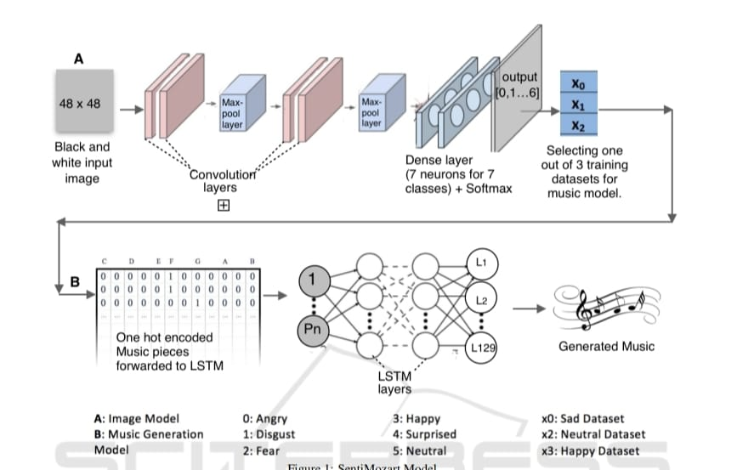
MODEL SELECTION :
ALGORITHM:
In MusicGen application the models used are RNN and CNNs(Convolution neural network ) a deep learning model that effectively recognize and classify facial expressions, while RNNs generate responsive and coherent music based on the detected emotions. Together, they create a seamless interaction between user emotions and music generation, resulting in a personalized musical experience.

Slide 11
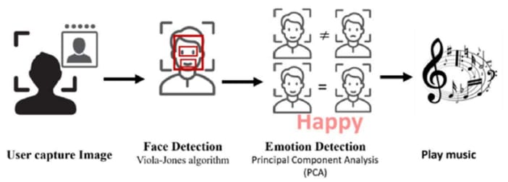
ARCHITECTURE:
ARCHITECTURE:

Slide 12
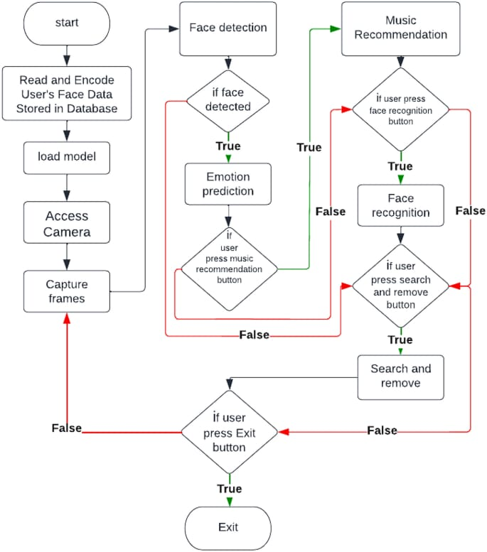

Slide 13
Conclusion
Project Conclusion
In conclusion, the facial expressions project aimed to explore the correlation between emotional cues and music preferences. By analyzing participants' facial responses to different musical genres, we found that specific emotions were consistently associated with particular types of music. For instance, upbeat songs elicited joy, while melancholic tunes evoked sadness.This suggests that facial expressions can serve as a valuable tool for understanding emotional responses to music, potentially enhancing personalized music recommendation systems. Future work could involve integrating these insights into applications that adapt playlists based on users' real-time emotional states, ultimately enriching the listening experience. Further research could also investigate cultural variations in emotional expression and music perception, providing a more comprehensive understanding of this relationship.

Slide 14
Future Scope
The Future scope of the music recommendation project using facial expressions includes several exciting avenues for exploration:
Real-Time Emotion Tracking: Developing apps that utilize facial recognition technology to analyze users' emotions in real-time and adjust playlists accordingly, enhancing the listening experience.
Broader Emotion Categories: Expanding the range of emotions analyzed beyond basic feelings to include more nuanced states, allowing for richer music recommendations.
Cultural Variations: Investigating how different cultures express emotions and respond to music, conducting long-term studies to understand how individual music preferences change over time and how they correlate with evolving understand how individual music preferences change over time and how they correlate with evolving emotional expressions.
By pursuing these areas, the project could significantly enhance our understanding of the interplay between emotion and music, leading to innovative applications in both personal and commercial contexts.

